Slide 1
Microservices And Serverless Course Introduction

Slide 2




What’s in it for you
Software development professionals can:
solutions using Cloud native technologies like microservices and serverless

Slide 3
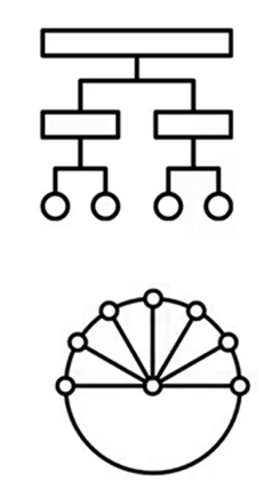
Why microservices?
Cloud computing solutions:
• Monolithic: One big application with all functions
• Difficult to maintain
• Microservices: Small applications
• Simplify maintenance
• Easily managed
• Provide speed
• Scalability
• Easy to build

Slide 4

What are microservices?
• Break down larger applications into
smaller pieces
• Are independently maintainable
and scalable
• Provides cost benefits and team
autonomy

Slide 5
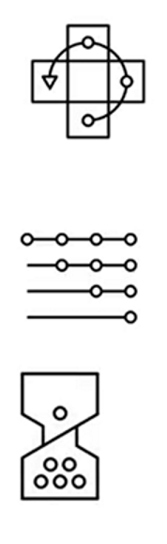
Why serverless?
• Ability to run applications without
managing underlying infrastructure
• Require only a serverless
architecture for the core code
• Apps deployed quickly and free up
resources when not in use

Slide 6

What you’ll learn
Create microservices and deploy with
serverless
• Module 1: Microservices Overview
• Module 2: REST APIs
• Module 3: Serverless Overview
• Module 4: Serverless with Cloud Engine
• Module 5: Final Project

Slide 7

How to get the most out of the course
View each
video
Complete
hands-on
labs
Check your
Learning with
each quiz
Contact us in
discussion
forum

